Slide 1
Class Background Survey

Slide 2
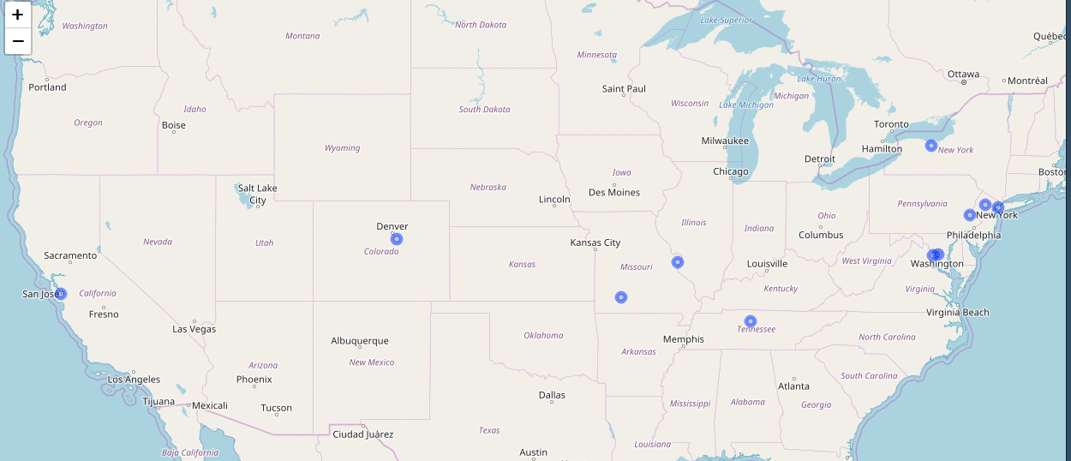
Geographical Distribution of the Students

Slide 3
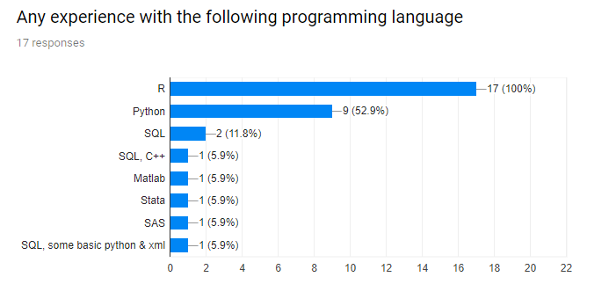

Slide 4
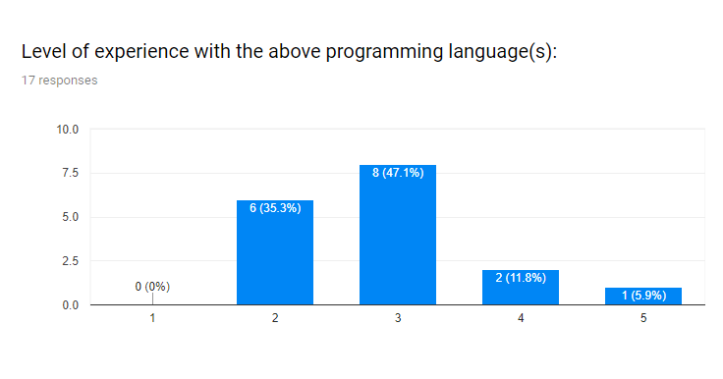

Slide 5
